Slide 1
EDUCATION ASSIGNMENT DASBOARD
A WEB-APP solely dedicated to the Assignments provided to the students as a part of their academic coursework
The objective is to facilitate the easy and transparent evaluation as well as submission of the assignments
The dashboard contains the student information, coursework, deadline, tracks assignments and the marks obtained by the students
CATEGORY - SOFTWARE
Team Members – Sumesh Thakur (1801180)
Sohan Lal Gupta (1801175)
Swapnil Aman (1801182)

Slide 2
Technology Stack
IDEA DESCRIPTION
A Web App which contains all the necessary information about the assignments of all the courses.
The dashboard contains vital details such as assignment deadline , track record of all the previous assignments in any given course, marks obtained, and personal information (Name, Roll no, Semester, etc.).
In the project, special provisions have been made for downloading and uploading relevant files, the professors can upload the questions and download the solutions while for the students the opposite provision has been given.
The proposal addresses a number of common problems that surround those specific parts of the coursework that are exclusively concerned with Assignments.
The main motivation was to provide transparency as far as marks obtained in the assignment is concerned.
REACT.js
USER INTERFACE
FRONT END
REDUX
OPTIMAL STATE
MANAGEMENT
MONGODB
DATABASE
Back
End
BACK
END
NODE.js
Runtime environment
EXPRESS
Framework of Node.js

Slide 3
Functional Requirements
The list of our functional requirements along with their visual representations are as follows :-
We created three actors
Students
Professors
Administrator
We will mention and highlight the functional requirements of all the three actors one-by-one.

Slide 4


Students

Slide 5
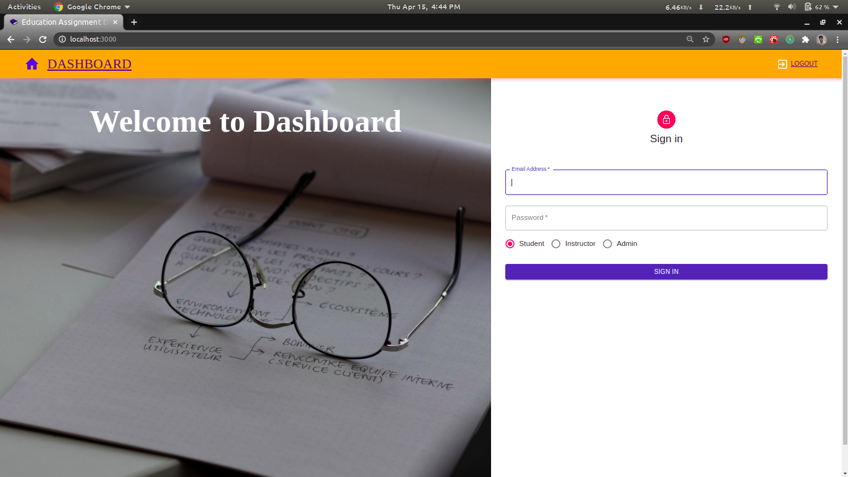
This is the initial page of our dashboard, from where all the three actors can log in to their respective accounts.
Firstly, we are going to proceed with all the functionalities related to the students.

Slide 6

Here, we tried to login using the credentials of an invalid user for the student field and as you can see, a message regarding the same was printed back to the user concerned.

Slide 7
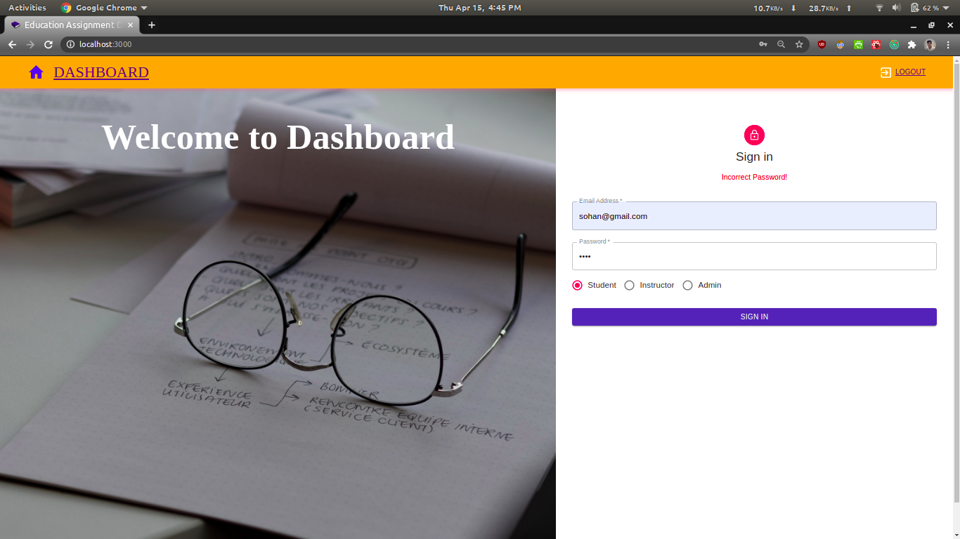
Here, we tried to login using the Email address of a valid user but the password was entered wrongly, for the student field and as you can see, a message regarding the password being incorrect was printed back to the user concerned.

Slide 8
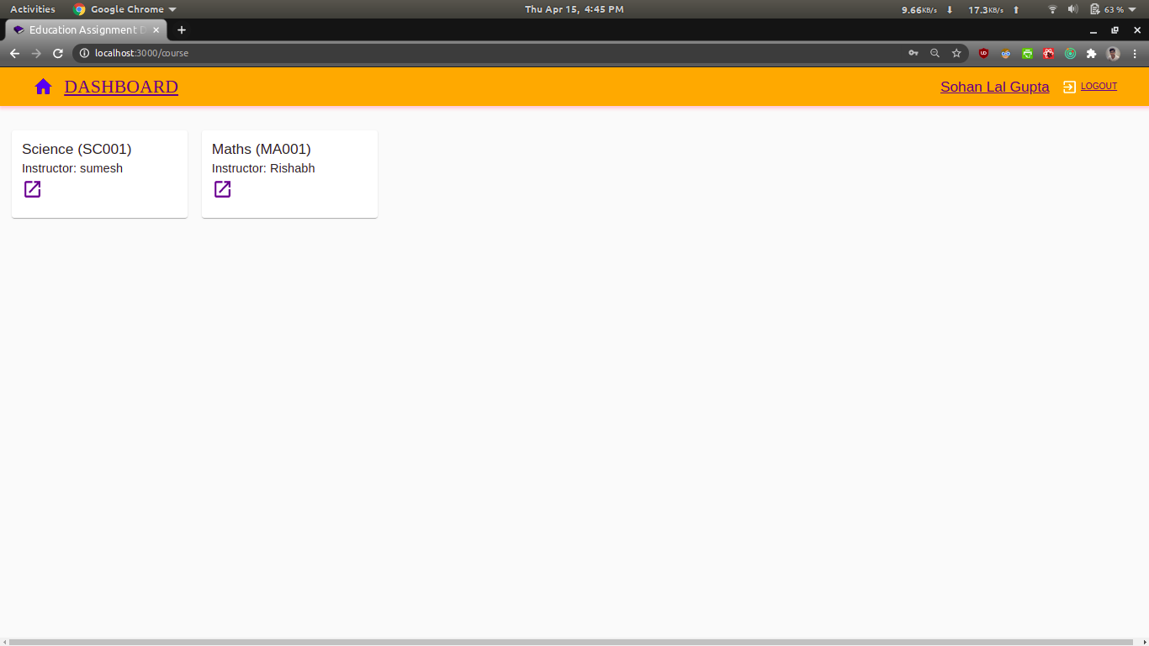
The student has successfully logged in and we can see the courses that he is studying along with the name of the respective professors.

Slide 9
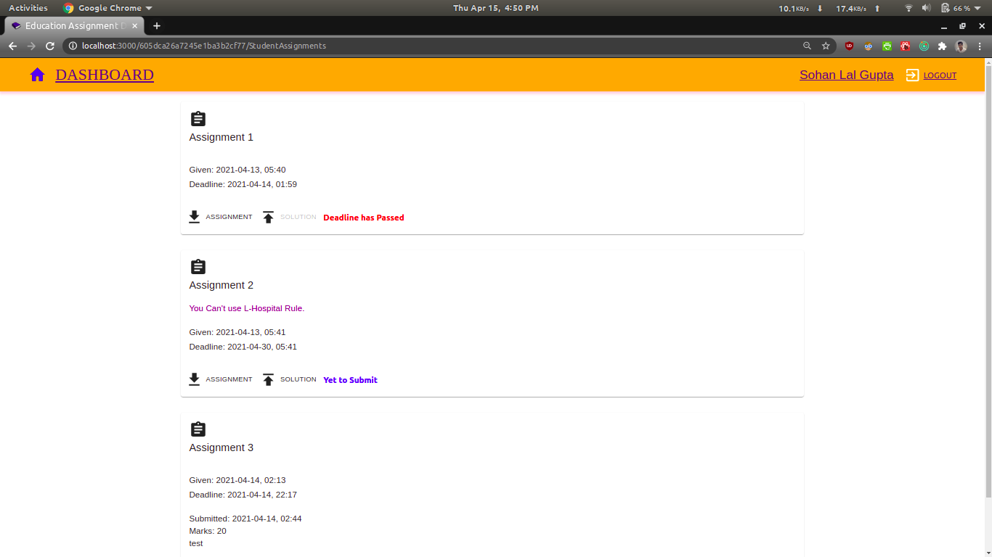
Here , the student has open one of the subjects and here he comes across all the assignments that were or have been given for this course.

Slide 10
This is the same slide as the one in the previous page Here the student is able to obtain three vital information regarding each of the three assignments
Assignment 1 - He didn’t submit it and the deadline has also passed, hence the solution button has been disabled.
Assignment 2 – He hasn’t submitted the solution yet, but the deadline of this assignment hasn’t passed, so he can still submit it.
Assignment 3 – The student has already submitted this assignment and has also obtained the marks for it.

Slide 11
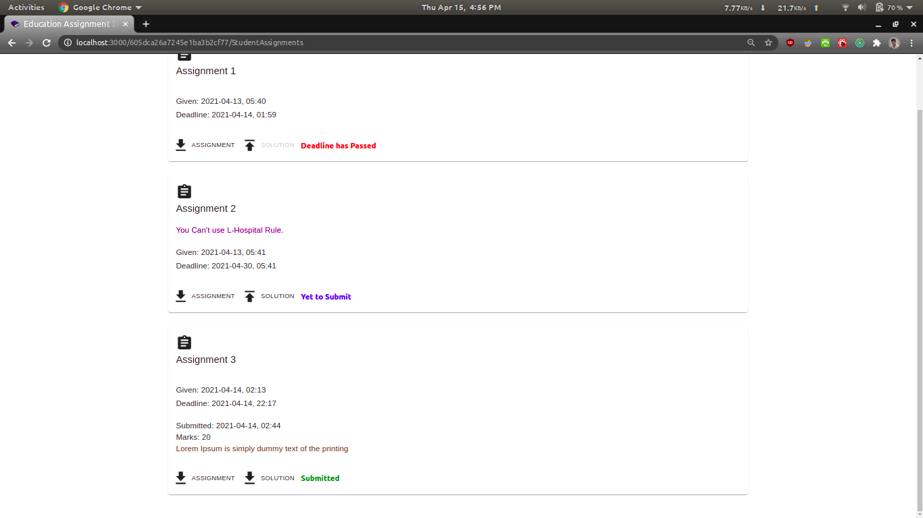
Here we can observe, that in Assignment 2, the professor has posted a comment along with the assignment highlighted in purple colour and in Assignment 3, the student posted his comments while submitting the solution and that is highlighted using brown colour.

Slide 12
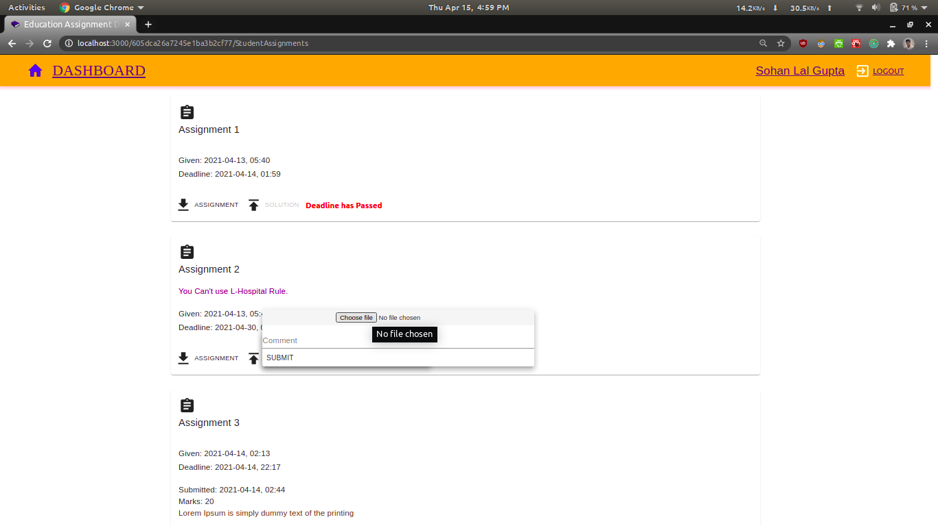
Now, we highlight the process of assignment submission-
In Assignment 2, the student clicks on the solution button and then he is presented with an option of choosing the corresponding file which contains the solution of the problem.

Slide 13
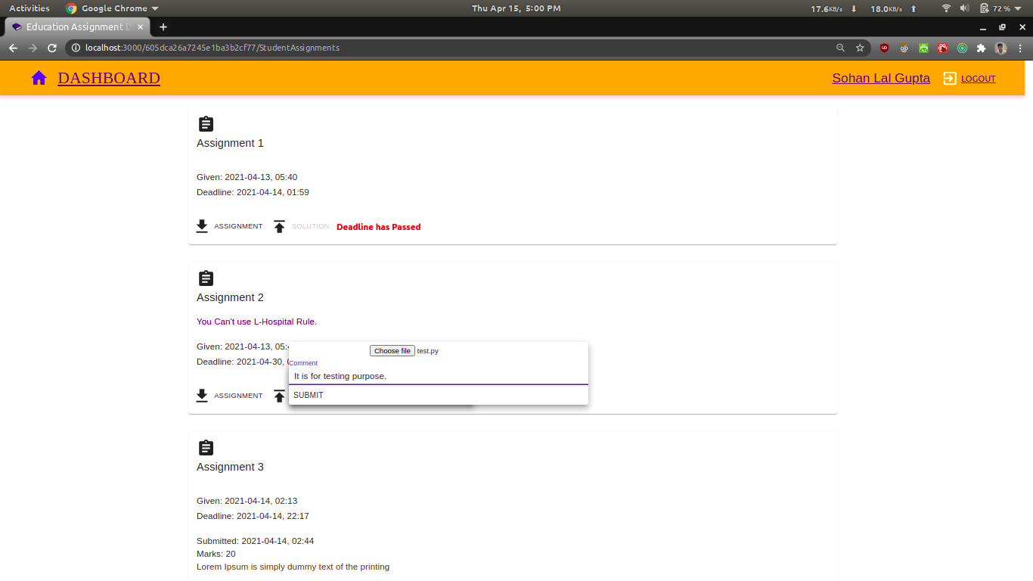
Here the student has chosen test.py as his proposed solution and also attached his own comment with the file.

Slide 14
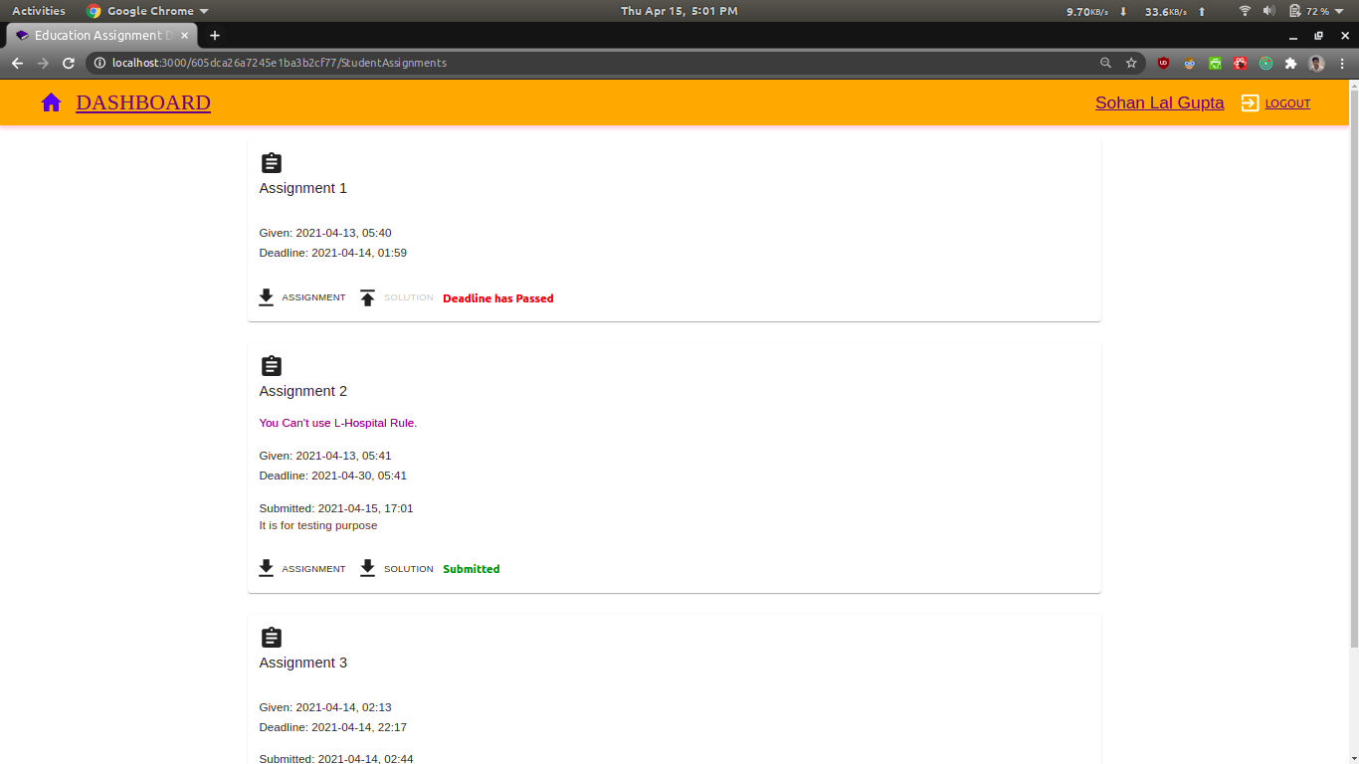
Here the student has submitted Assignment 2 and the status has been changed from “yet to submit” to “submitted” and his comment have also been added.

Slide 15

This completed all the functionalities for the student, now we will move towards the functionalities of the professors.

Slide 16

PROFESSORS

Slide 17

Here, a professor is trying to log in as the instructor field has been checked by him.

Slide 18
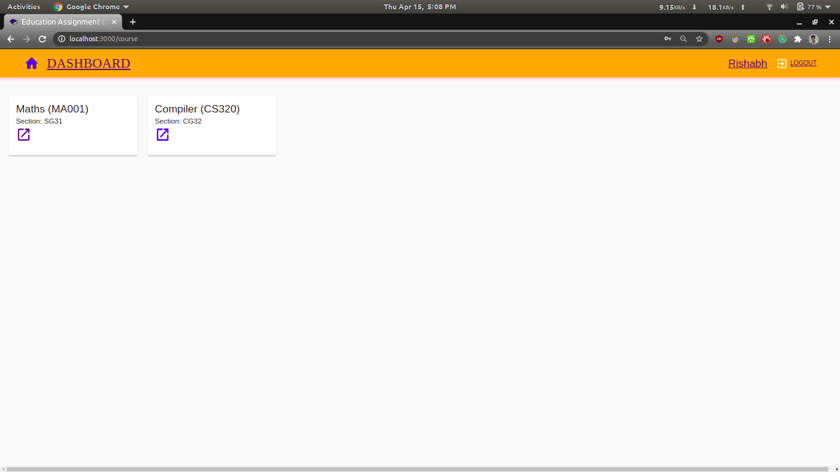
Here, a professor is shown the course that he is teaching along with the section name of the students who are going to take the course.

Slide 19
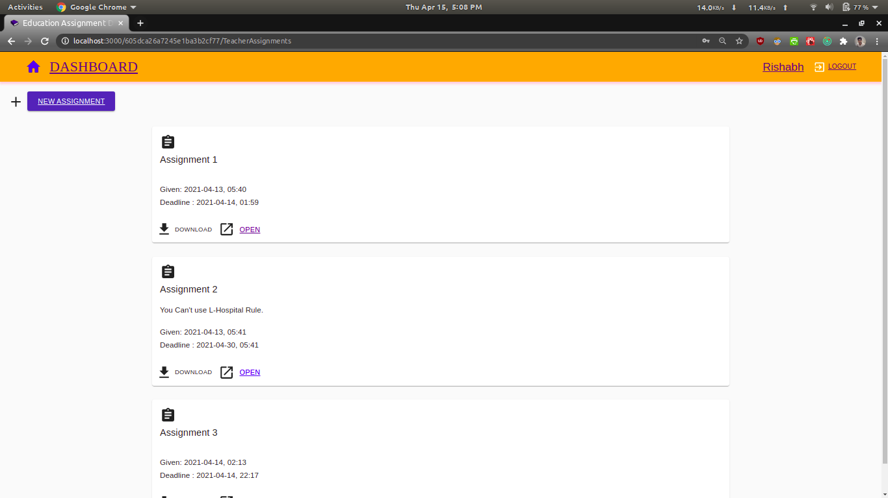
Here, a professor is shown all the assignments that he has given to the students, so far in the course.

Slide 20
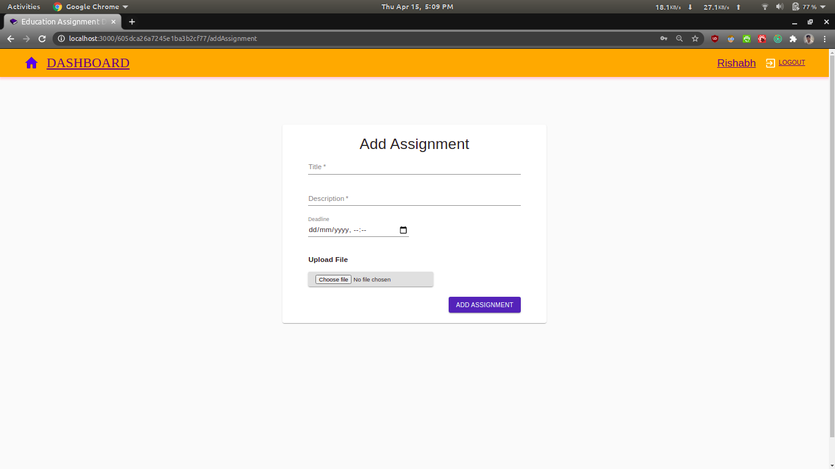
Now, we are going to show the process of adding a new assignment by the professor, he reaches this page by clicking on the new assignment button present in the previous page.

Slide 21
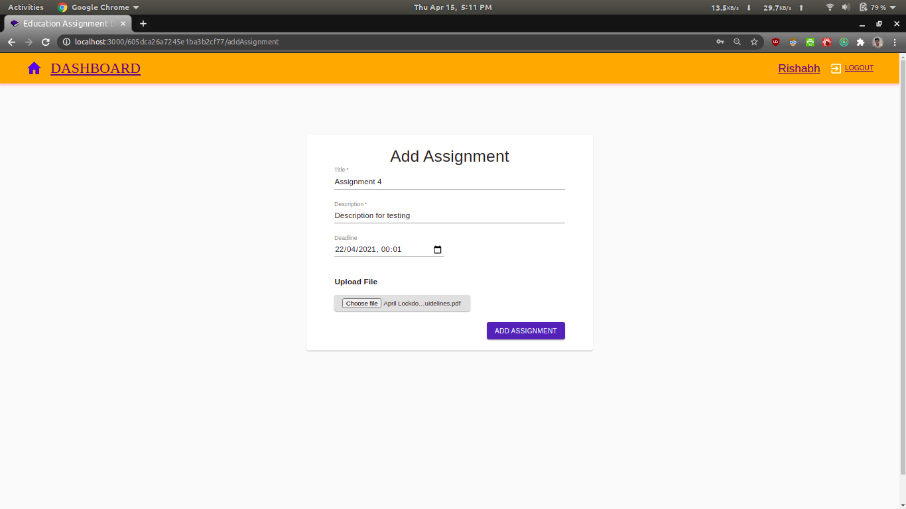
Here, the professor has filled in all the information related to the new assignment and has also selected the file to be uploaded.

Slide 22
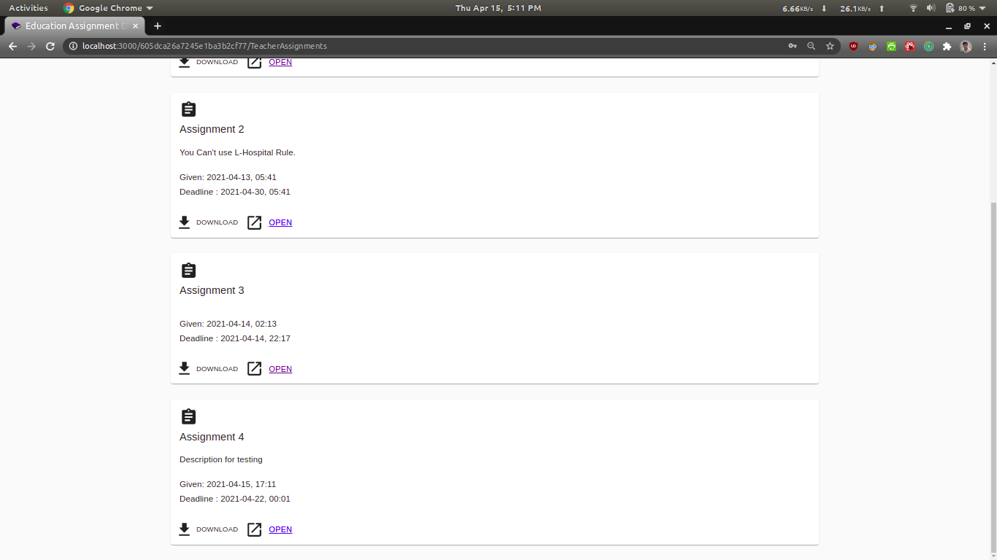
We can clearly see that the 4rth Assignment has been added along with it are the professor’s comments, the upload date and the deadline of the assignment.

Slide 23
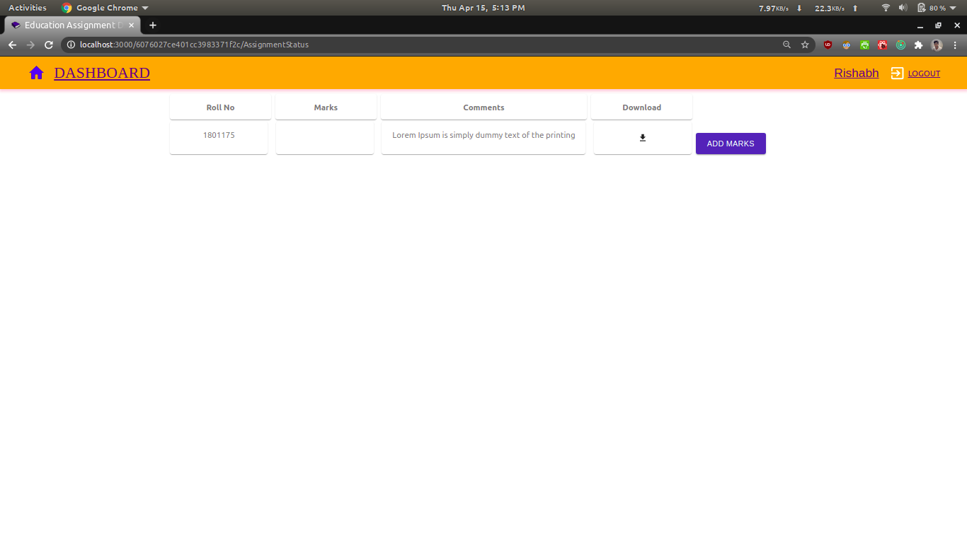
After clicking on the open button, the professor is directed to the page containing all the submissions, here we can see that only one student has submitted till now. The professor can download the solution by clicking on the download button.

Slide 24
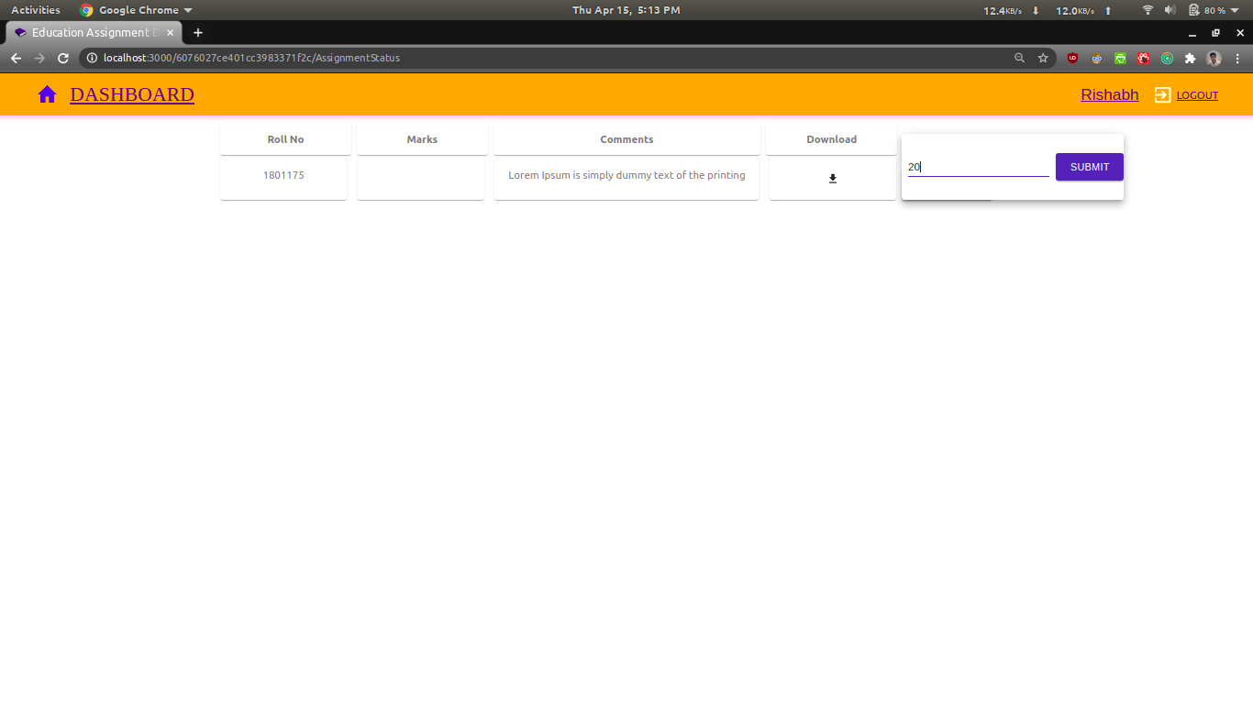
Here, after checking the assignment, we can see that the professor is allotting 20 marks to the person who had submitted the assignment.

Slide 25

The allotted marks have been successfully added against the roll number of the concerned student.

Slide 26
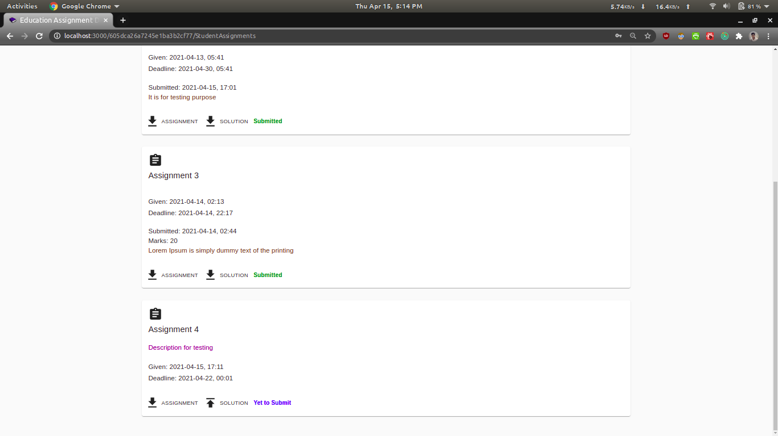
For a student who hasn’t submitted the assignment 4, his/her dashboard would look like this.

Slide 27

This completed all the functionalities for the professors, now we will move towards the functionalities of the Admin.

Slide 28

ADMINISTRATOR

Slide 29
What is the role of the admin ?
Their role is to assign appropriate professors to their scheduled courses and the appropriate students to the courses they will study.
The admin incorporates the changes in the dashboard with the help of an excel sheet which will contain the details of the students, professors, and the courses beforehand.

Slide 30

The admin is trying to Sign in into his account.

Slide 31
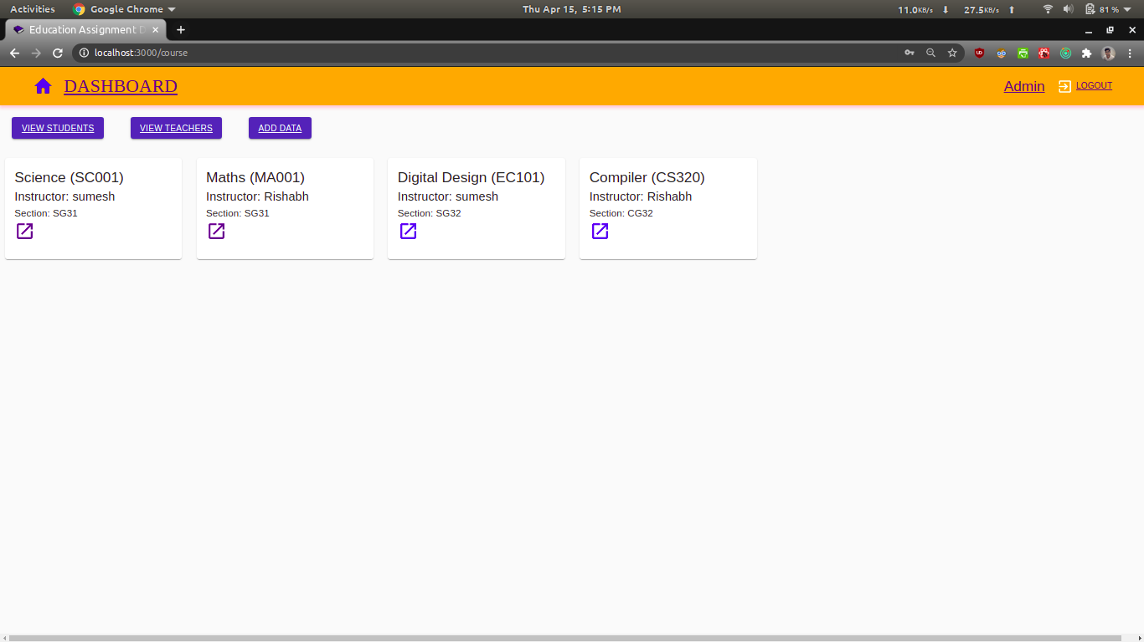
This is what the admin’s initial page looks like. He can see all the courses along with their corresponding instructor and section name. He has also been provided with the feature of viewing details of all the students and professors along with adding new data.

Slide 32
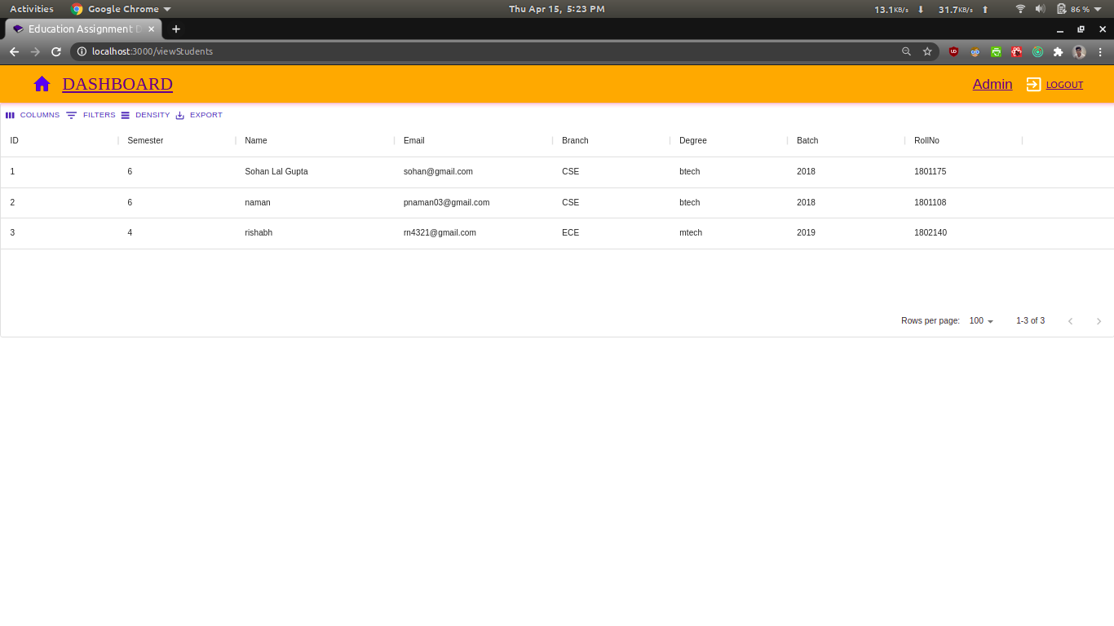
The admin is able to view the details of all the students after clicking on “View Students”.

Slide 33
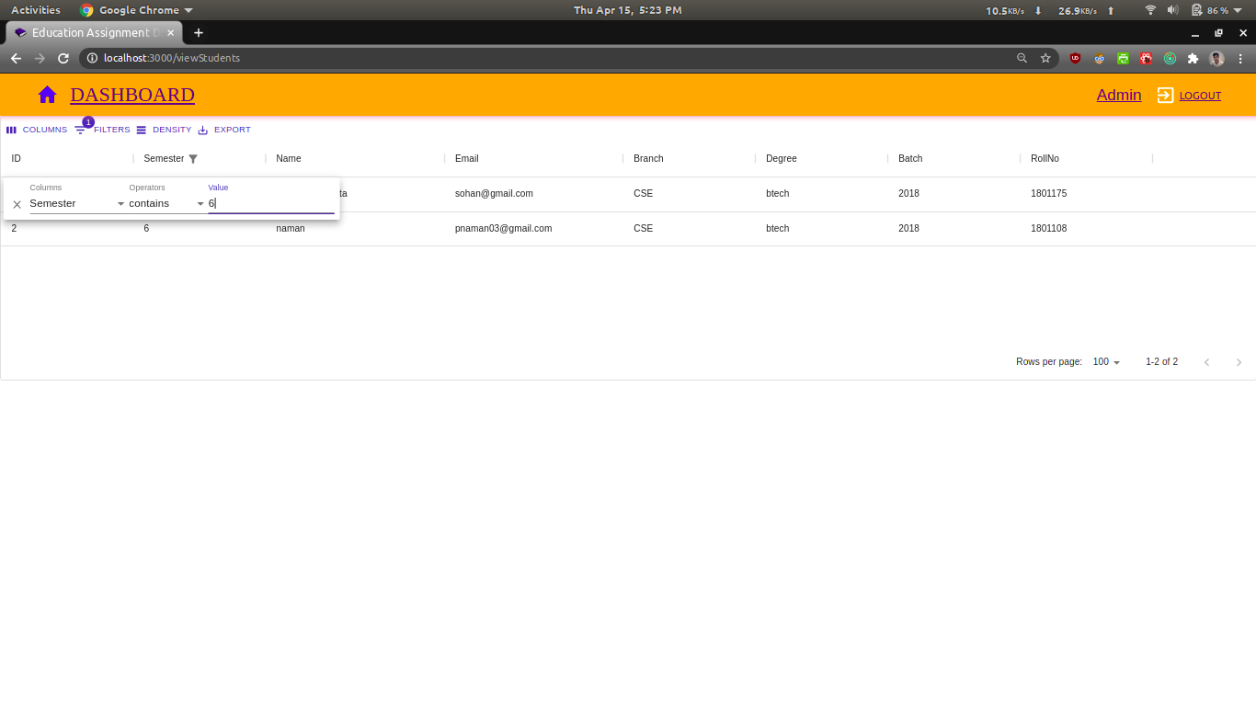
After applying the filter Semester = 6 ,The admin is able to view the details of only those students who are currently in the 6th semester.

Slide 34
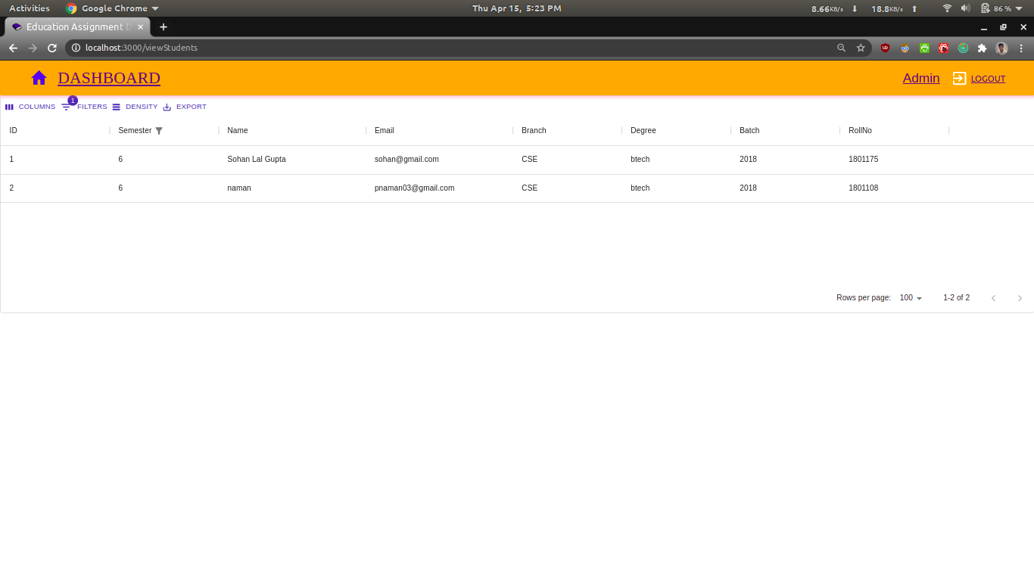
List of students in Semester 6.

Slide 35
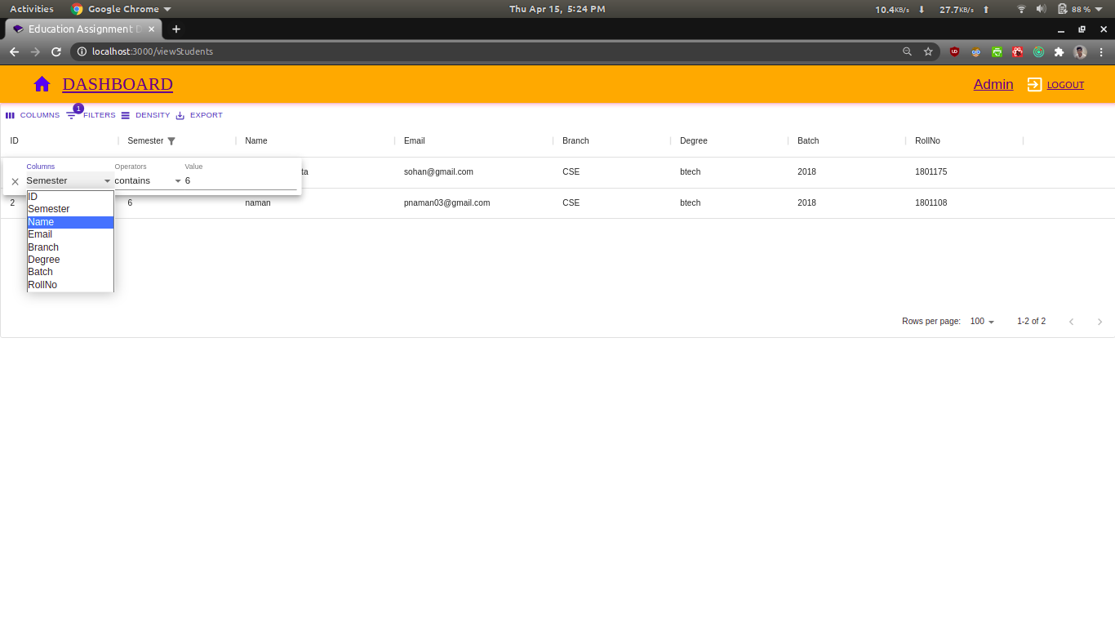
Apart from the semester filter, the admin can also apply other filters for viewing details of the students. The various types of filters are ID, Semester, Name, Email, Branch, Degree, Batch, and Roll number.

Slide 36

Here the admin is applying constraints on the branch of the student.

Slide 37
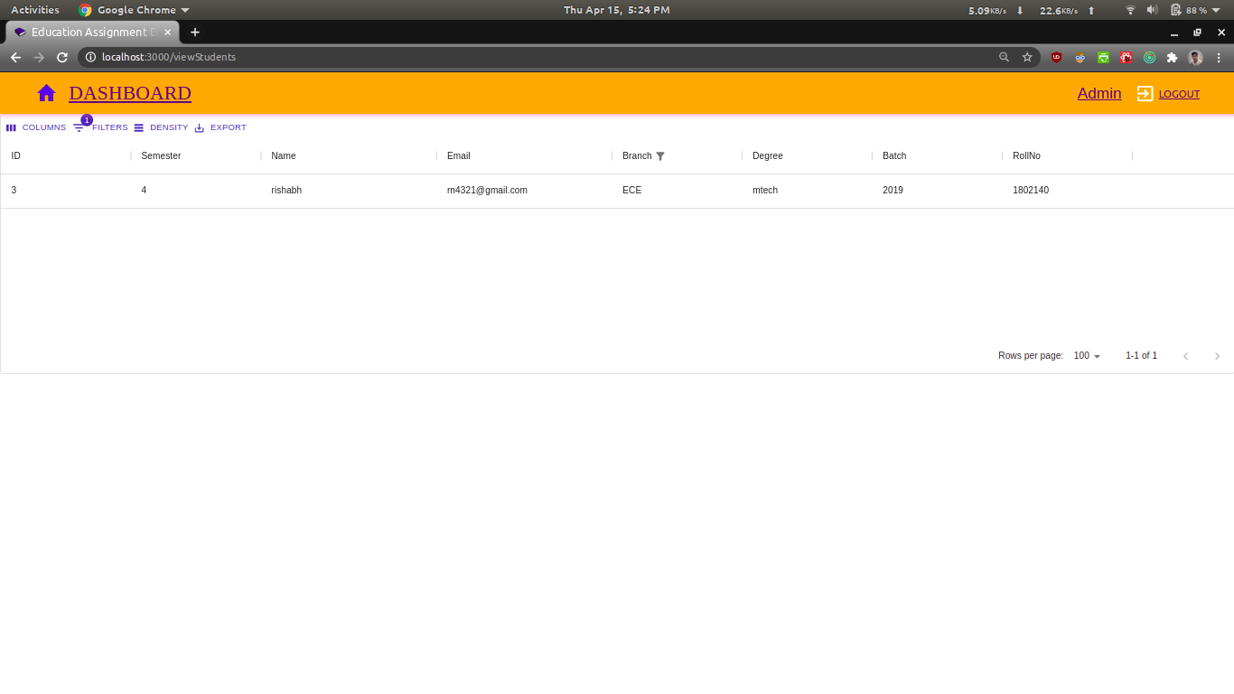
The result of the previous filter are highlighted here.

Slide 38
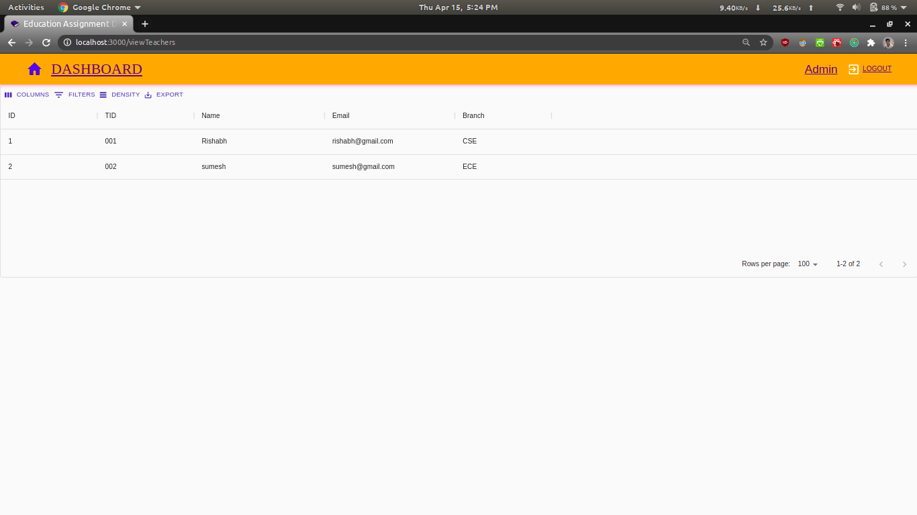
The admin is able to view the details of all the professors after clicking on “View Teachers”.

Slide 39
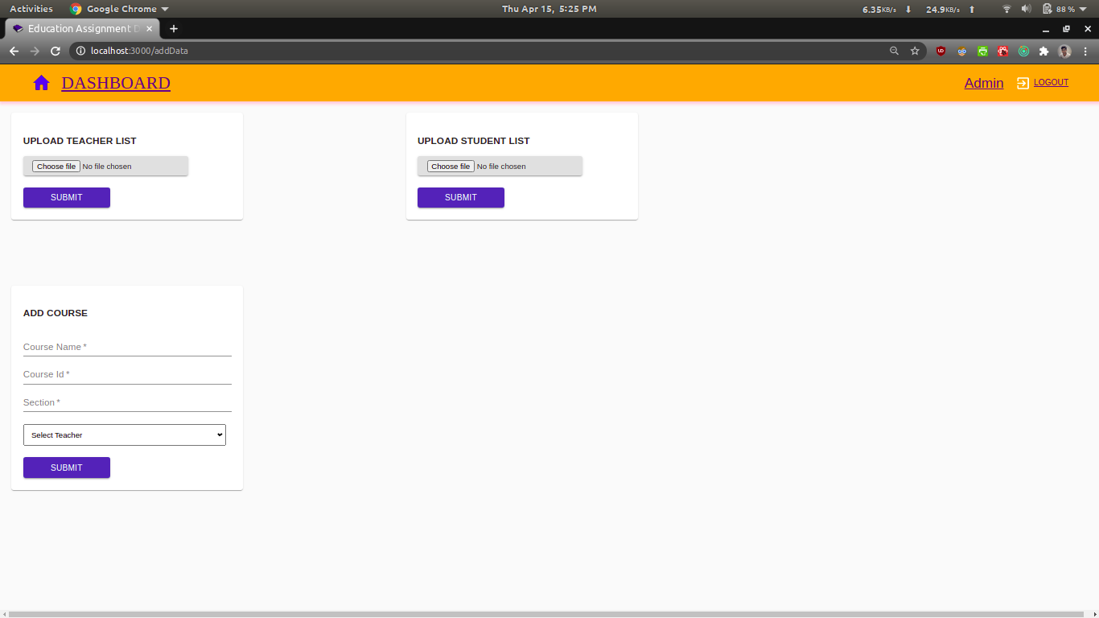
Here, the admin has clicked on the add data button and henceforth, he is directed to this page. Here, he can upload either the list of the teachers or the list of the students using an excel file and can also add new courses manually.

Slide 40

The admin has chosen a student.xls file for the purpose of adding a set of new students.

Slide 41
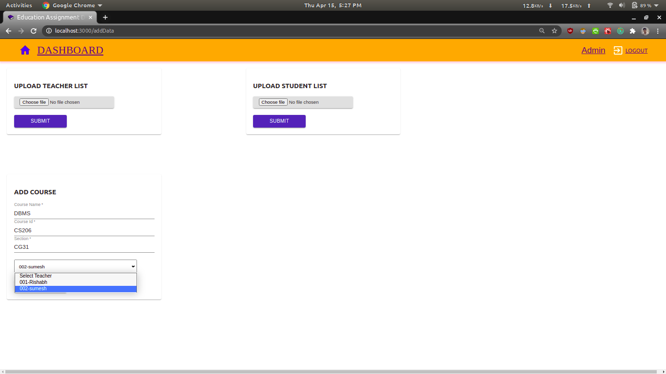
The admin is adding a new course after entering all the relevant details. Here we can see the admin is wanting to select a professor out of the possible two.

Slide 42
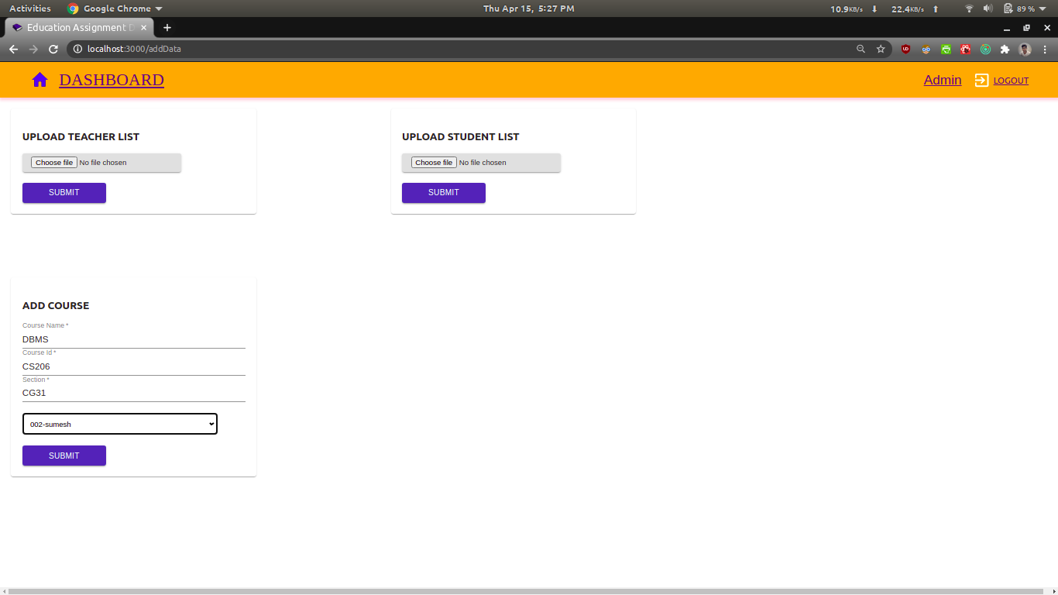
The admin is adding a new course after entering all the relevant details.

Slide 43
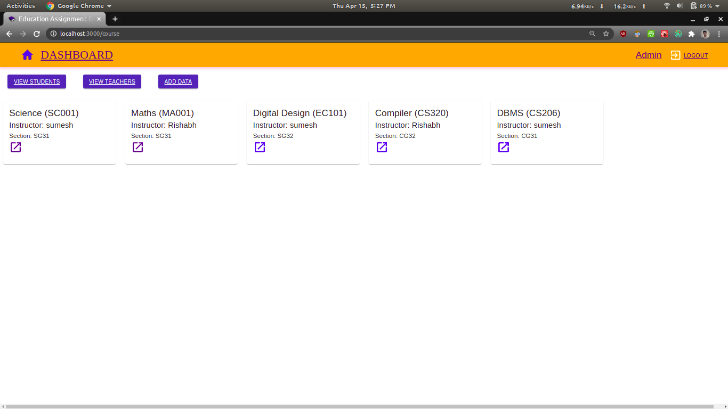
We can see that the new course named DBMS has been added to the list of courses.

Slide 44
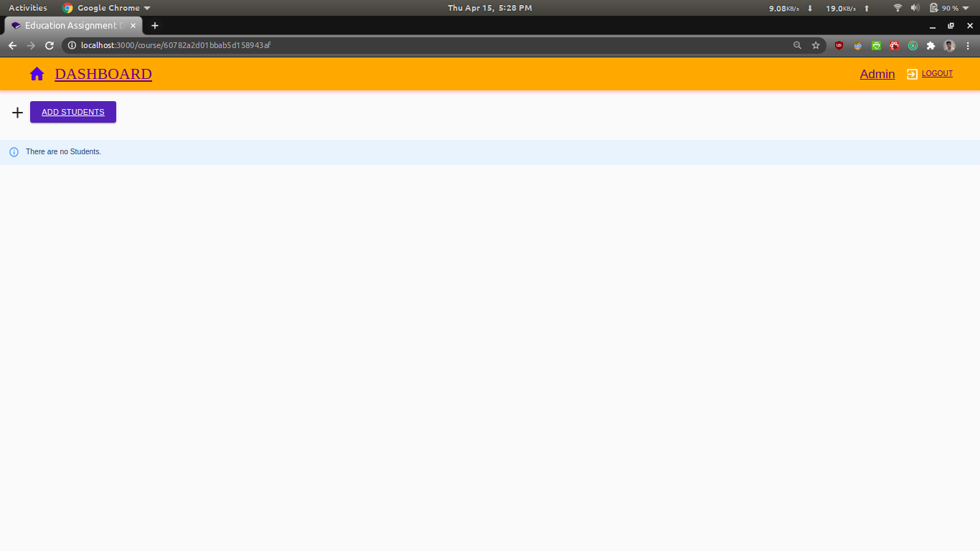
Now, We will highlight the process of adding new students to a particular course.

Slide 45
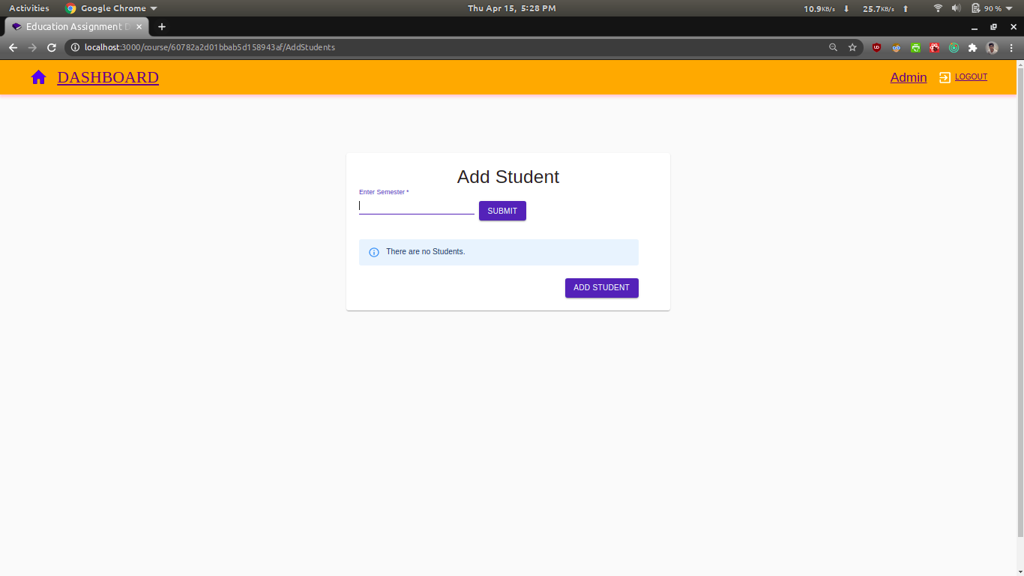
First, the admin has to enter the semester to which the new students belong to.

Slide 46
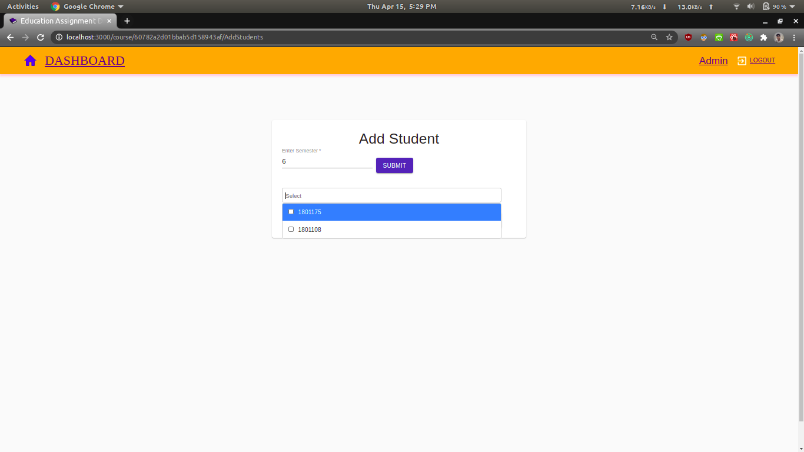
Then, from the list present in the drop down, the admin selects the roll no of the students he wants to add.

Slide 47
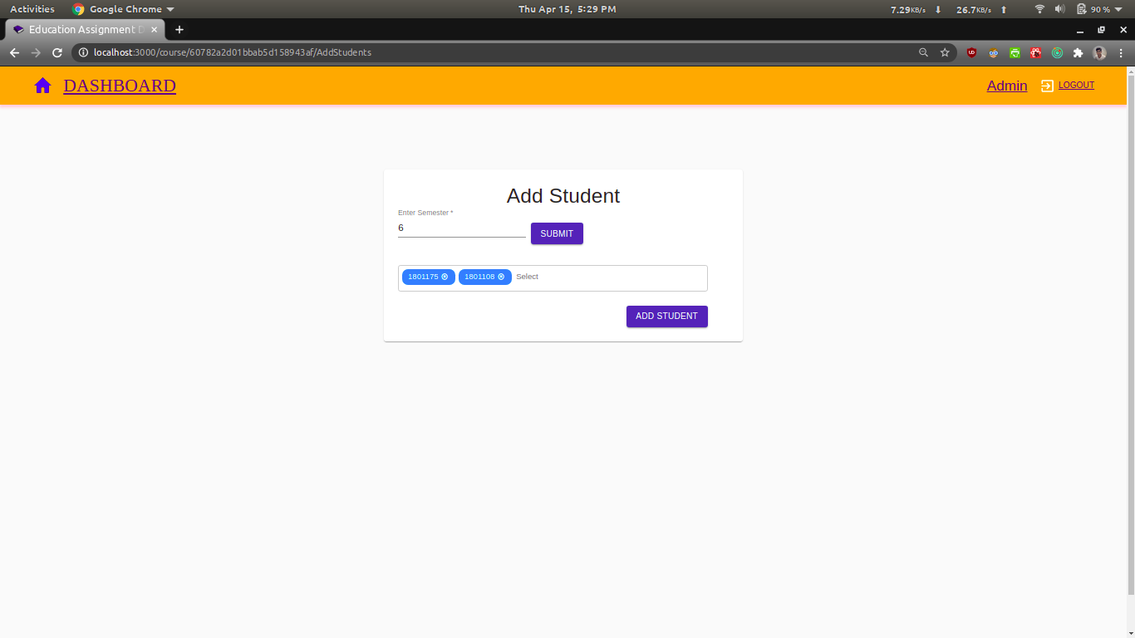
Then, from the list present in the drop down, the admin selects the roll no of the students he wants to ask, and now all he needs to do is to click on the add student button and they’ll be added.

Slide 48
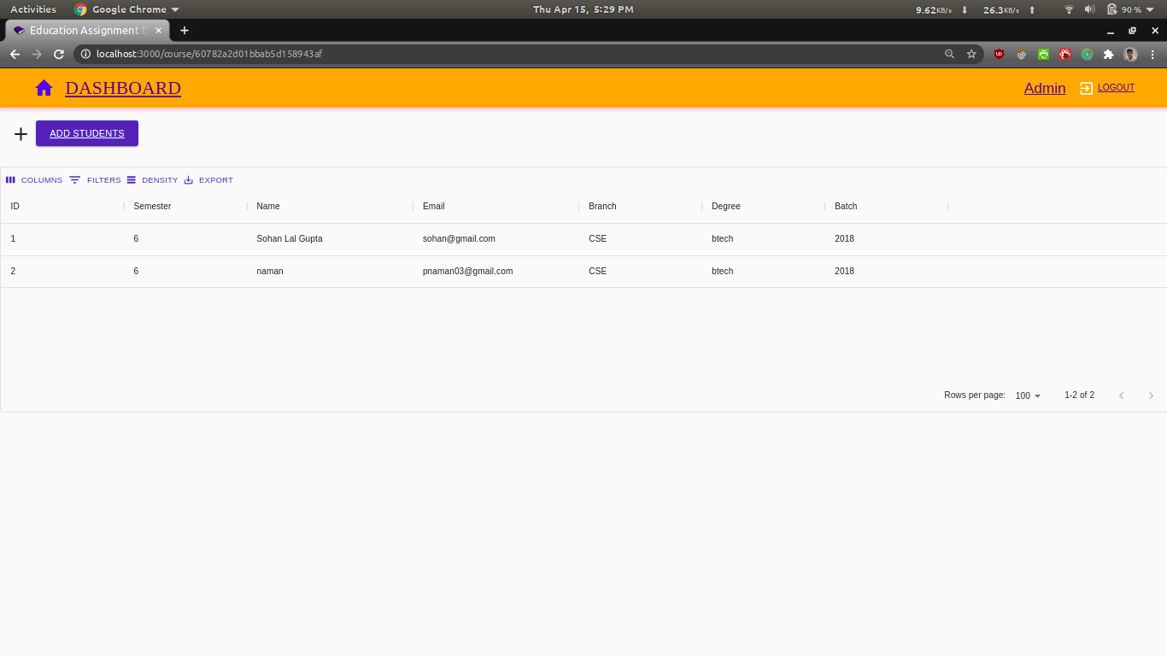
We can clearly see that the two students have been added to the DBMS course.

Slide 49

This concludes the visual representation of the functional requirements of our projects.

Slide 50
Individual contributions
Sumesh Thakur - Worked on the frontend part using react.js . Wrote action, constants and reducers. Worked on integrating backend with frontend.
Sohan Lal Gupta- Worked on backend with Node.js. Wrote API's and routes . Also worked on integrating fronted with backend by providing routes in frontend.
Swapnil Aman - Worked on the database part using Mongo DB . Also Created schemas and wrote API's and routes in backend. Played a crucial part in writing the report and the presentation.
Other significant tasks such as creating the diagrams like DFD and USE case was done by all the three members working together.

Slide 51
CONCLUSION
This project was highly enjoyable and we got to learn a lot of new concepts while we were preparing it.
Future exploration into this particular aspect involves the integration of our Assignment dashboard with the result portal that the members of some other group had proposed to make. Since, ours is a very flexible web app, any changes that the institute may desire in the future shall be duly brought into place.

Slide 52


